Slide 1


Healthy High Streets in Bradford
By (names removed for anonymity)

Slide 2
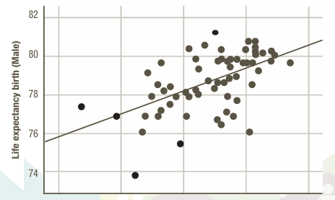
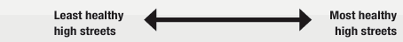
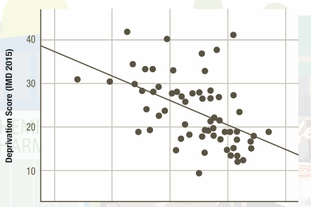
Background
Research has found key links between unhealthy high streets, deprivation and life expectancy (RSPH, 2018)
High streets can lead to a decline in health due to shops such as ‘payday lenders, bookmakers, tanning salons and fast-food outlets’ (Brunelli et al., 2024, p. 2)
Unhealthy high streets often exacerbate existing inequalities – there is an issue of bookmakers and payday lenders deliberately targeting poorer communities
Bradford was found to have the 10th unhealthiest high streets in Britain (RSPH, 2018)
The city has a high proportion of under-19s, as well as significant numbers of Muslim and Christian communities (Braford District Council, no date)
What makes a high street healthy?
(RSPH, 2018, p. 30)
Notes:
We looked at healthy high streets in Bradford. A healthy high street is important for many factors, like life expectancy, equality, and deprivation. Shops like payday lenders, gambling sites, fast food restaurants can contribute to a high street being unhealthy. And often these businesses target areas often target poorer and more deprived areas, which leads to even more inequality.
So, looking at Bradford specifically, it was found to be have the 10th unhealthiest high streets. The city has a high population of Muslim and Christians, as well as under 19s. I suppose the bigger question is what makes a high street healthy - its quite a subjective question.

Slide 3
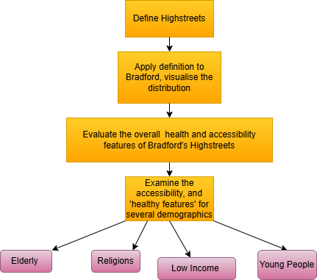
Approach and Objective
Deep dive into Bradford’s high streets - analysis on Bradford only
Focused on the city high streets of Bradford rather than outlying towns within the district
Identified the needs of different demographic groups
‘Zoomed in’ on a general overview of healthy high streets
Notes:
So, for our approach, we firstly defined high streets. We then applied this definition to Bradford, and began visualising our results. We then looked at an general overview of Bradford’s high streets, it's greenspace, air quality, and more. Next we wanted to identify different demographic groups, like the elderly, young people, low income, and religious people and use certain high streets in Bradford to understand how the high streets catered to that group. Sort of like zooming in on the general overview.

Slide 4
Data Description
Name | Description | Data Type | Source (URL)
CDRC Points of Interest | Includes retail, hospitality and service establishments as data points | .CSV (Comma Separated Values) | https://data.cdrc.ac.uk/dataset/point-interest-data-united-kingdom
Census | Dataset provides Census 2021 that classify usual residents in England by single year of age | .CSV (Comma Separated Values) | https://www.ons.gov.uk/datasets/TS007/editions/2021/versions/3/filter-outputs/6f116aff-090c-41ff-9e1b-ed3320f07286#get-data
Fully Halal Food Map (Non-Stunned, Hand Zabiha) - Halal Food Gastronomy | Provides point and description data of fully Halal/Vegan/HMC certified restaurants | .KML converted to .GDF | https://www.google.com/maps/d/u/0/viewer?mid=1IVs1nWridqLqNq6vNWKYTSw9nxNQ9ULD&ll=53.78840101604163%2C-1.763801933804281&z=14
Out-Of-Work Benefits Census | Provides the number of claimants as a proportion of resident population of area aged 16-64 and gender | .CSV (Comma Separated Values) | https://www.nomisweb.co.uk/reports/lmp/la/1946157124/report.aspx?town=Bradford
Public Toilets | Dataset containing locations of public toilets in Bradford | .CSV (Comma Separated Values) | https://www.toiletmap.org.uk/
Traffic Data | Average annual flow data for roads in Bradford. | .CSV (Comma Separated Values) | https://roadtraffic.dft.gov.uk/local-authorities/195
Notes:
We used the CDRC dataset of Points of Interest (POIs) which includes retail, hospitality and service establishments as datapoints for clustering. We also used census data to see which demographics were present in the area served by a highstreet. For specific datasets such as Public Toilets, Halal Food Map and Traffic data.

Slide 5
Defining High Streets
OS definition of a high street, a minimum of 15 retail establishments with 150m of each other
DB Scan: better suited for this type of spatial clustering than k-means due to the non-uniform shape of highstreets, the presence of lone establishments that need not be in a cluster, and the unknown quantity of highstreets; do not need to specify cluster number
Parameters; ε = 0.15/6371 (km radian⁻¹) equiv. 150m, haversine distances, MinPts = 15
Algorithmic performance: Good for the inner suburbs and highstreets in residential areas, poor for the city centre, the whole of the central business district is classed in one cluster
Solution: rerun DBScan on subset of BD1 only, with a smaller ε value (75m); results in different clusters across different locations in the city centre
Notes:
We used the Ordinance Survey definition of a highstreet as a street with a minimum of 15 retail establishments within 150m of one another. To identify the highstreets we chose the DB Scan algorithm. This was preferable to k-means for example as the number of clusters is not known, and the clusters may be of non-uniform shape, and the presence of some lone establishments that are not on a highstreet, that could be classified as outliers. The algorithm performed particularly well for the innercity residential areas and suburbs, but poorly for the city centre, due to the much higher density of establishments in this area. To define separate the highstreets within this region, we reran DB Scan on a subset of the data (BD1 only) with different parameters.

Slide 6
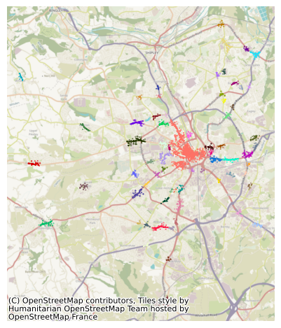
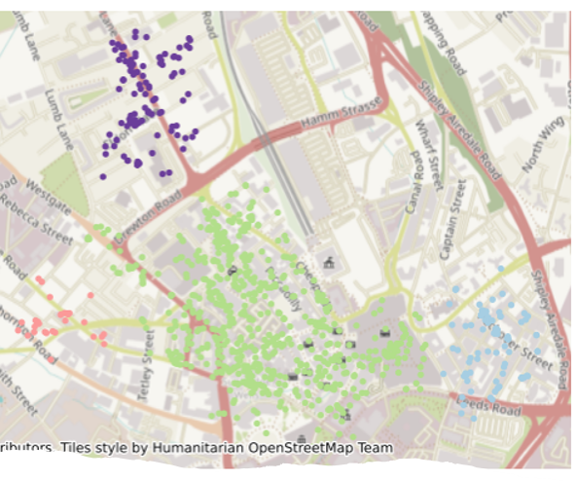
Bradford's High Streets: An Overview
Thackley High St
Apperley Bridge
Manningham Ln
Thornton High St
Toller Ln
Little Germany
Four Ln Ends
Leeds Rd
Manningham Ln
Great Horton Rd
Manchester Rd
Central Shopping Area
Wibsey High St

Slide 7
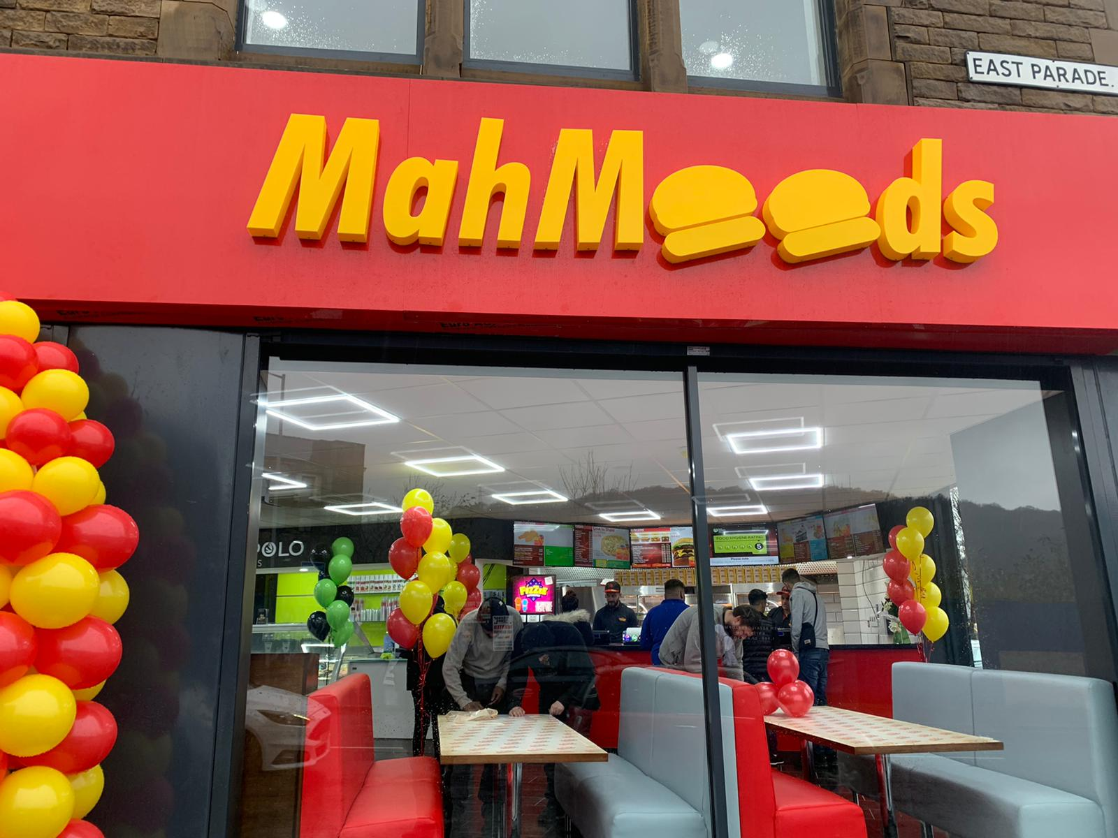
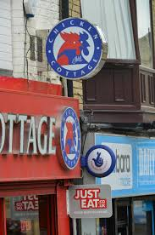
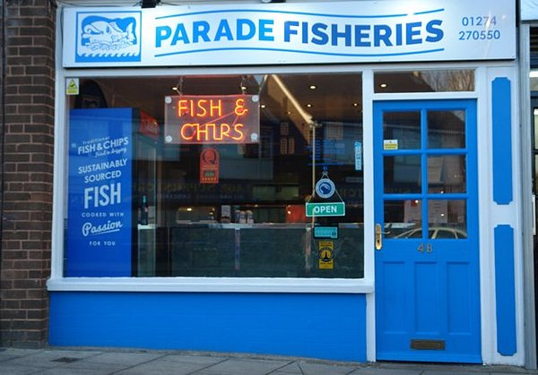
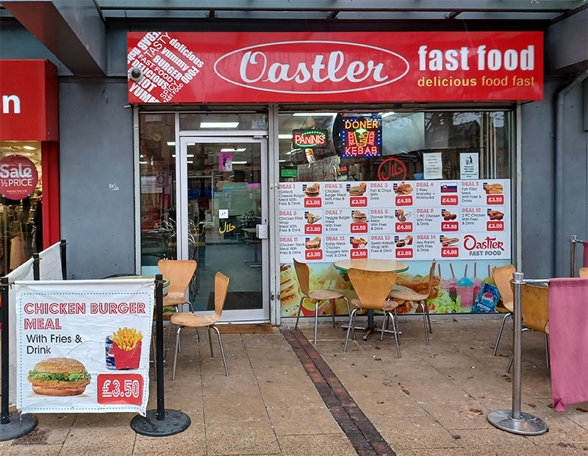
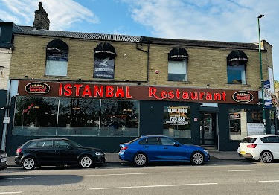
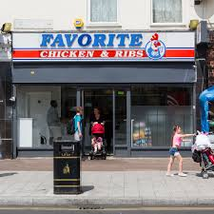
Fast-food on Bradford’s High Streets
Research found that 4,000 new fast-food outlets had opened across the UK from 2013 to 2018 – with a higher concentration in poorer areas (Butler, 2017)
Within Bradford,180 takeaways were open for business in 2010, but eight years later the number has gone up rapidly to 420 (Macnamara, 2018)
A poll by local Bradford newspaper revealed 84 per cent of participants agreed that Bradford has too many takeaways
Public Health England found in the Bradford district there are 142.1 fast food outlets per 100,000 people – the second highest in Yorkshire (Jagger, 2018)
Fraser et al.'s (2012) study found that out of 1198 pregnant women studied within Bradford, more than 95% of all participants lived within 500 m of a fast-food outlet
Notes:
- Further research found that 36% of food retail outlets in the Bradford are occupied by fast food
- with South Asian women having greater access to all food stores including fast food outlets in comparison to non-South Asian women

Slide 8
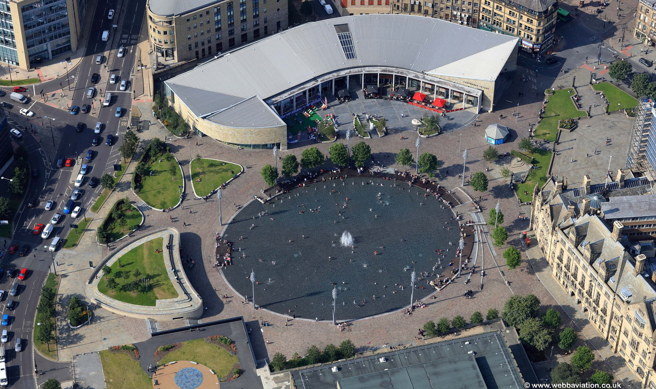
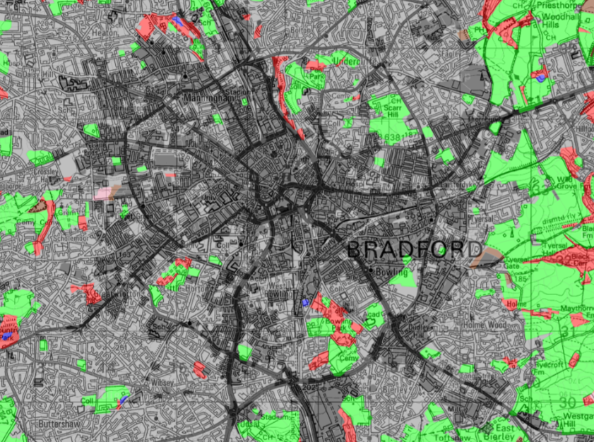
Green Space and Air Quality within Bradford's High Streets
Greenspace -
The map demonstrates a lack of open green areas within the ring road (A6177) around the Bradford city centre, with the only notable parks in the centre being city park
There is evident green space in the Northwest region within the ring-road but still is a significant distance from the city centre (Digimap, 2021)
Air quality -
The lack of green space in Central Bradford, has culminated in the PM2.5 (particulate matter with a diameter equal to or less than 2.5 micrometres) concentration being 5.8 times higher than the World Health Organization annual PM2.5 guideline value at 29.2 µg/m³ (IQ Air, 2023)
Weather recording software from AccuWeather rates Bradford's air quality as poor, recording an AQI score of 78 (AccuWeather, 2022)
City park, Bradford
Digimap of Greenspace in Bradford

Slide 9
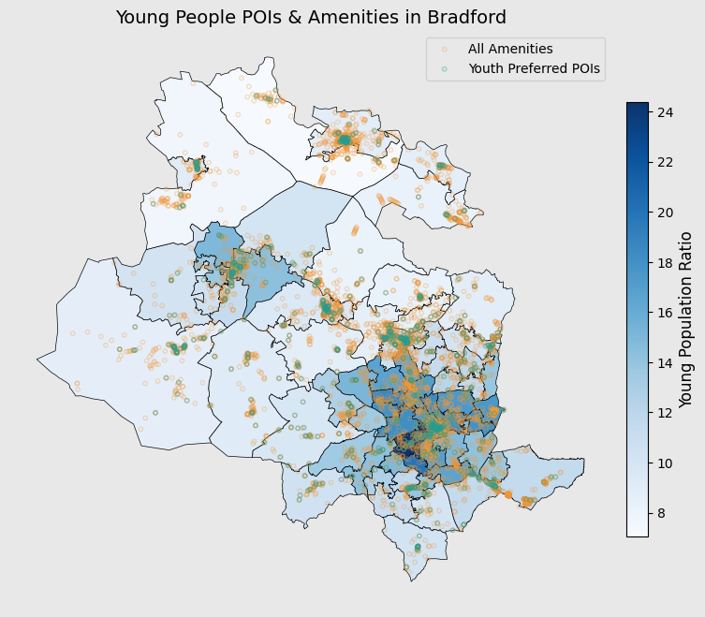
High Streets: Social Hubs for Young People
High streets are not only commercial centers but also key hubs for young people's social and cultural activities -- linked to their high social demand, include leisure, entertainment, social interaction, and self-expression (Carmona, 2015)
Young people are more inclined to choose urban spaces with open social environments, such as cafés and pub, rather than traditional large shopping malls (Brady et al., 2020)
Youth consumption patterns are often concentrated in affordable, fast-paced venues such as fast-food outlets, beverage shops, and entertainment spaces (Carmona, 2015)

Slide 10
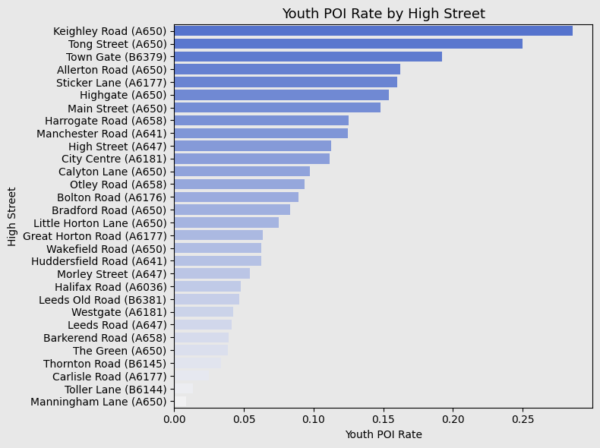

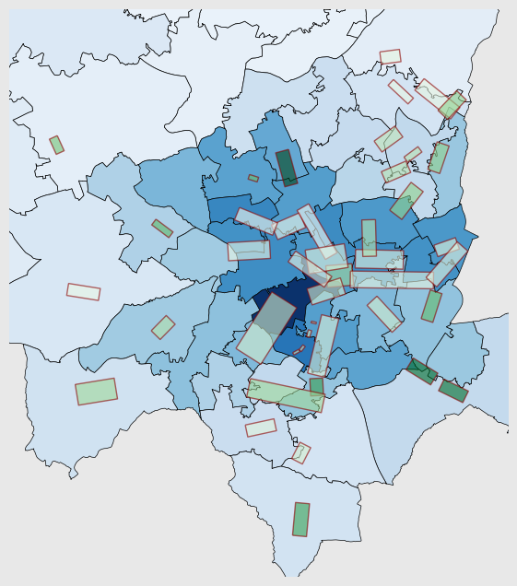
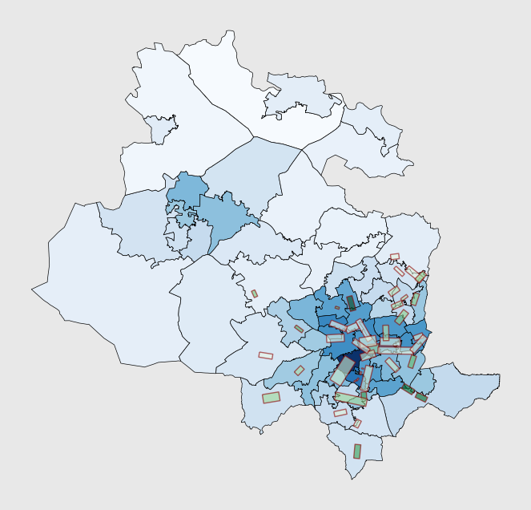
High Streets in Bradford: Youth-Friendly
Youth friendly high street
Traditional high street
Top1: Keighley Road
Bottom 1: Manningham Lane
Youth-friendly rate by high street

Slide 11
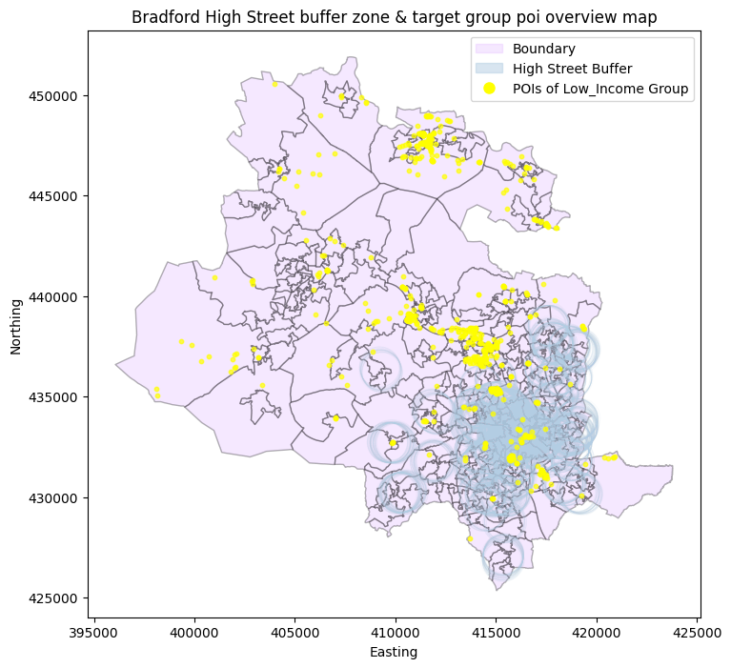
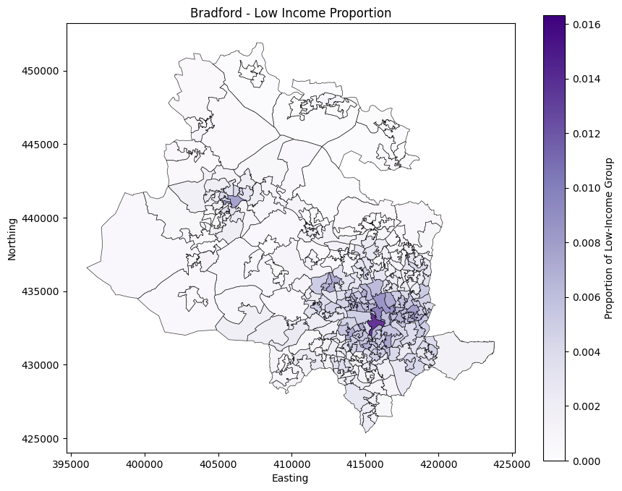
Healthy High Streets by Low Income Group
POI Selection:
Discount stores
Charity stores
Welfare communities
Fast food
Public facilities
- POIs of target group are not densely distributed within the High Street buffer
- Most are commercial high streets with a focus on retail industries

Slide 12
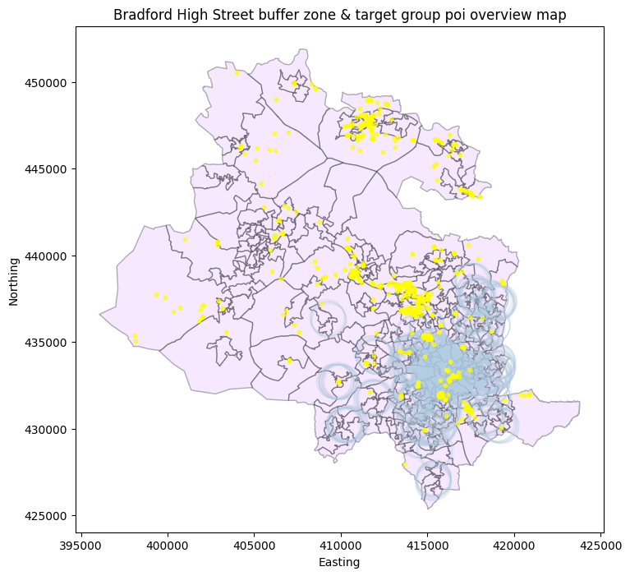
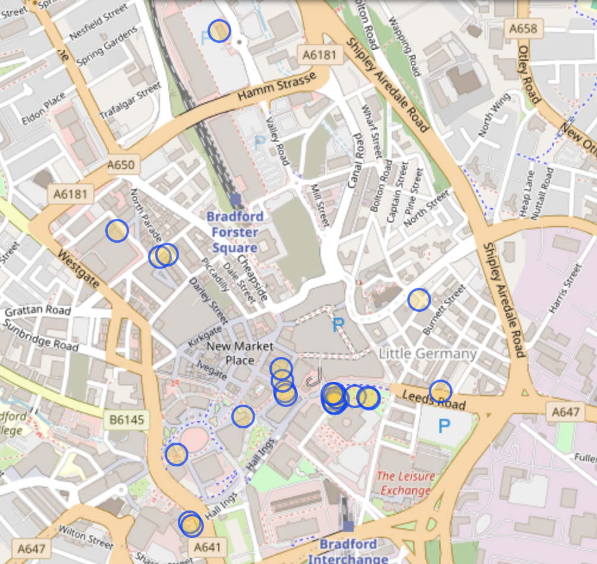
Healthy Highstreets by Low Income Group: Bradford City Center
Medium Low-Income Population Rate Area
Centered on Leeds Road, Market Street
Incomplete coverage of POI types, most are public establishments
Rental subsidies for discount stores, charity stores, and small supermarkets.
Establishment of temporary low-cost service points in vacant High Street storefronts (Madanipour, 2017).

Slide 13
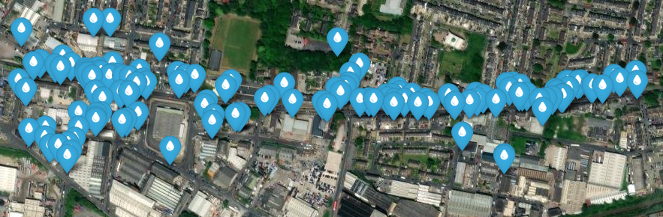
Healthy High Streets for the Elderly: Leeds Road, BD3
Serves the areas of Barkerend, East Bowling and Laisterdyke
10,455 people per square km
Over 65 population 6-11% of population in these wards, similar to other Bradford inner city areas, lower than outlying areas in district and much lower than UK average (19%)
Does the high street cater soley for the younger demographic? Is this high street still accessible for elderly population?
Notes:
Here we examined how Leeds Rd, a highstreet serving the Barkerend and Thornbury areas in BD3, catered to the elder demographic. The elderly population (6-11% depending on ward) is relatively low compared to the UK average (19%). Very high population density in this area.

Slide 14
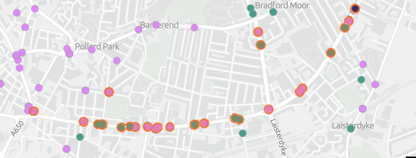
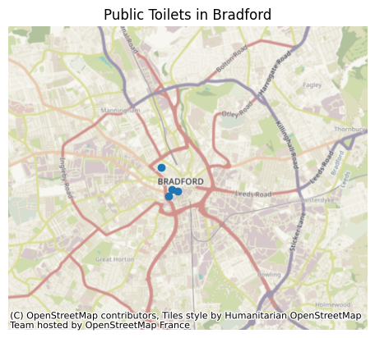
There were 176 POI's and 94 different main categories of POI on Leeds Rd, the most common were restaurants, retail, fast food, & clothing stores
Medical Centres: None, Nearest GPs on Barkerend Rd, approx 15 min walk
Libraries/Community Spaces: 1
Maintained, wide, flat footpaths and pavements
Pedestrian crossings and traffic segregation
Public bathroom facilities
Benches / resting places
Feeling of safety
Public transport
Pedestrian traffic accidents 2023: 28, 1 death
Leeds Rd lacks public toilets, which may make it less accessible for the elderly or families with young children
Number of Traffic Light controlled Pedestrian Crossings: 9 (approx every 300m)
Of the 1413 complaints related to Traffic and Road Safety in 2024 for Bradford District, 304 (22%) where in the two wards covered by Leeds Rd, but only accounts for 7.7% of Bradford Districts Population
Bus Stops: Leeds Rd is served by the 72 and X6 buses, 7 bus stops on each side of the road evenly spaced; this highstreet is well served for public transport
Notes:
From the Healthy High Streets doc published by Public Health England, the important factors for elderly access to a high street were pedestrian crossings, safety, public bathrooms, community places / resting places and public transport. Leeds Rd is lacking in public bathroom access, as is bradford as a whole with public toilets only located in the city centre and some further out towns centres in the district. The street is well served by public transport having 7 bus stops either side evenly spaced down the road with 2 services, and the street has a traffic light controlled pedestrian crossing on average every 300m. The wards covering this highstreet have a proportionally higher amount of complaints to the Traffic and Road Safety Department of Bradford City Council, suggesting there may be issues with traffic and pedestrian safety in the area, which may make the highstreet feel less safe to the elderly population.

Slide 15
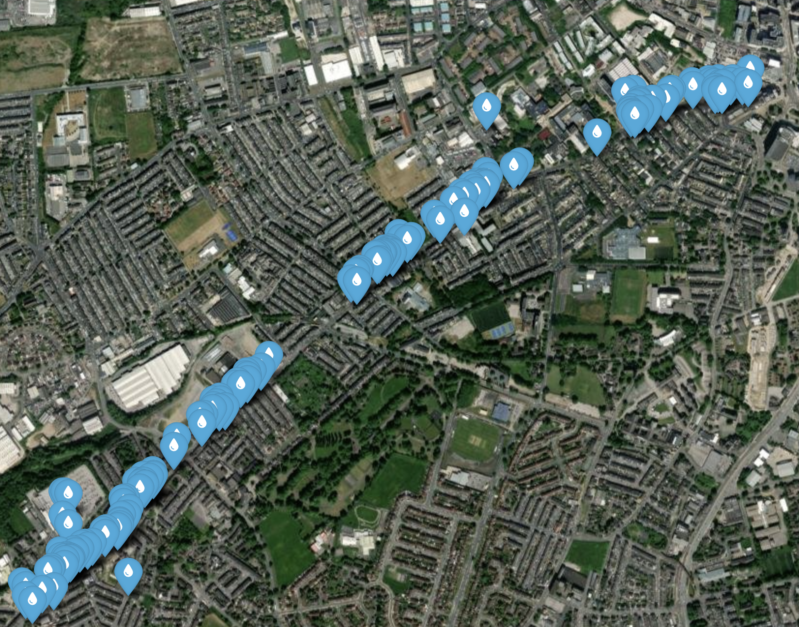
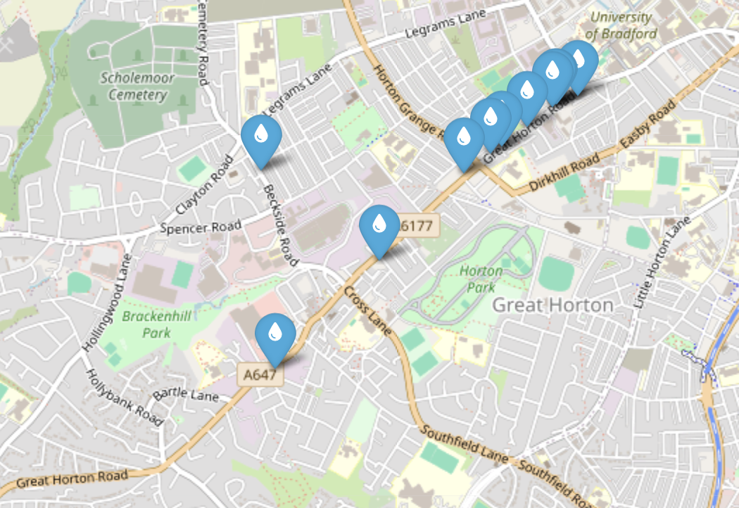
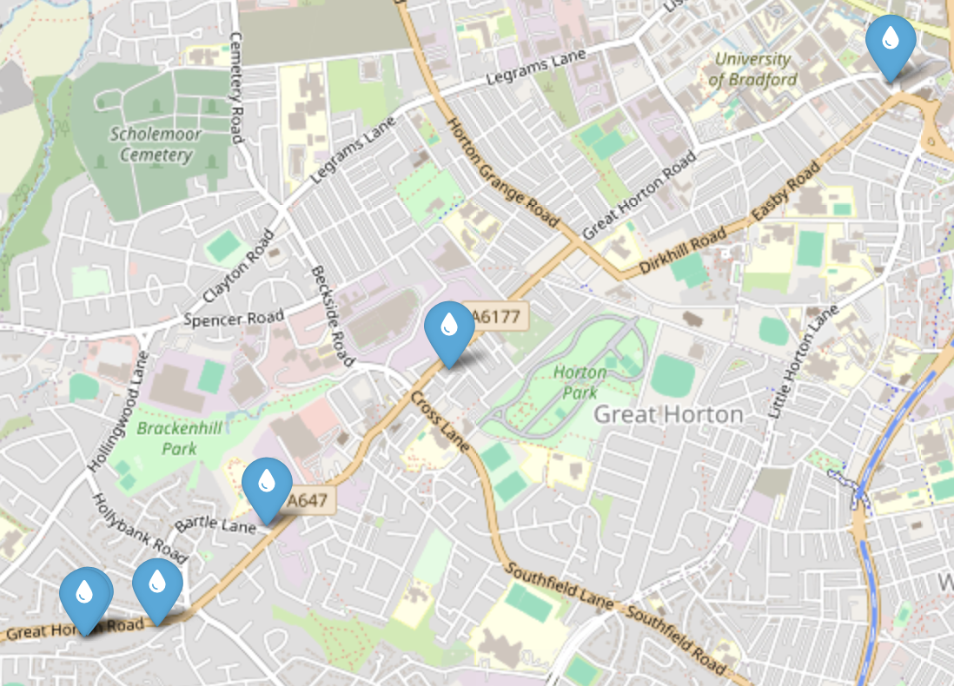
Healthy High Streets by Religion: Great Horton Road
All POIs
Halal Restaurants
Religious Establishments
Great Horton Ward’s population is made of around 60% Muslims, having the 7th highest Muslim population out of all wards in Bradford (Bradford District Council, 2023)
Great Horton Road has 164 POIs, including:
6 religious establishments – mosques, churches
10 fully halal restaurants (potentially more)
However, these restaurants are mostly fast-food restaurants
More POIs could be identified – inclusivity, safety, etc.
Notes:
So here we looked religion, and wanted to see how the Great Horton Road high street cluster catered to religious people. This ward is actually made up of 60% Muslims, so I looked specifically at religious establishments and halal restaurants. Out of 164 points of interest, there were 6 religious establishments, like churches and mosques and 10 fully halal restaurants. However, a lot of these restaurants were fast food… so is it still healthy?

Slide 16
Limitations and Future Work
DB Scan; further tweaking of parameters ε and minPts for better delineation of inner-city highstreets. The highstreets in Bradford city centre were not in as discrete clusters as the surrounding inner city, and suburban highstreets were.
The POI selection relies on OpenStreetMap (OSM) and there may be cases where not all POIs are fully recorded, especially small or non-chain stores may be missed.
Could go on to analyse Liverpool’s high streets and compare healthiness across cities.
Further detailed analysis of individual highstreets in Bradford, and expansion to cover further demographic groups - focusing on individual demographic groups like religion and age do not consider intersectionality.
Refine definition of high street?

Slide 17
Thank you!
Any questions?

Slide 18
References
AccuWeather 2022. Bradford, Bradford, United Kingdom. Accuweather.com. [Online]. Available from: https://www.accuweather.com/en/gb/bradford/bd1-5/air-quality-index/331294.
Archibong, U. and Colins, D. 2022. ONE BRADFORD, MANY VOICES: Social Integration Research [Online]. University of Bradford. Available from: https://bradfordforeveryone.co.uk/wp-content/uploads/2023/02/Social-Integration-Research-Full-Report.pdf.
Bradford Metropolitan District Council. No date. Demographics of Bradford District. [Online]. Bradford: Bradford Metropolitan District Council. [Accessed 10 March 2025]. Available from: https://jsna.bradford.gov.uk/media/52sbbext/jsna-demographic-resource-pack-2024.pdf
Bradford Metropolitan District Council. 2023. 2021 Census: population, ethnicity and households at ward level. [Online]. Bradford: Bradford Metropolitan District Council. [Accessed 10 March 2025]. Available from: https://ubd.bradford.gov.uk/media/1692/2021-census-ward-level-data-for-population-ethnicity-religion-and-household-composition.pdf
Bradford Transforming Cities Fund 2021. Bradford City Centre Cycling and Walking Improvements Phase 1 Consultation and Engagement Report.
Brady, B., Chaskin, R.J. and McGregor, C. 2020. Promoting civic and political engagement among marginalized urban youth in three cities: Strategies and challenges. Child and Youth Services Review. [Online]. 110, p.105184. [Accessed 10 March 2025]. Available from: https://doi.org/10.1016/j.childyouth.2020.105184
Brunelli, L., Smith, H., Woolrych, R. 2024. High streets, ageing and well-being. Journal of Urban Design. [Online]. pp. 1-31. [Accessed 10 March 2025]. Available from: https://doi.org/10.1080/13574809.2024.2302436
Butler, P. 2017. Large Rise in Takeaway Shops Highlights Dominance of Fast Food in Deprived Areas. the Guardian. [Online]. Available from: https://www.theguardian.com/inequality/2017/jul/25/large-rise-takeaway-shops-highlights-dominance-fast-food-deprived-areas-england.
Carmona, M. 2014. London's local high streets: The problems, potential and complexities of mixed street corridors. Progress in Planning. [Online]. 100, pp.1-84. [Accessed 10 March 2025]. Available from: https://doi.org/10.1016/j.progress.2014.03.001
Digimap 2021. Environment Roam. Edina.ac.uk. [Online]. Available from: https://digimap.edina.ac.uk/roam/map/environment.
Fraser, L.K., Edwards, K.L., Tominitz, M., Clarke, G.P. and Hill, A.J. 2012. Food outlet availability, deprivation and obesity in a multi-ethnic sample of pregnant women in Bradford, UK. Social Science & Medicine. 75(6), pp.1048–1056.
IQ Air 2023. Bradford Air Quality Index (AQI) and United Kingdom Air Pollution | IQAir. www.iqair.com. [Online]. Available from: https://www.iqair.com/gb/uk/england/bradford.
Jagger, D. 2018. Restrict children’s access to fast food takeaways says Public Health England. Bradford Telegraph and Argus. [Online]. [Accessed 7 March 2025]. Available from: https://www.thetelegraphandargus.co.uk/news/16321601.restrict-childrens-access-fast-food-takeaways-says-public-health-england.
Macnamara, F. 2018. Bradford Ranks among ‘unhealthiest’ British High Streets. Bradford Telegraph and Argus. [Online]. [Accessed 7 March 2025]. Available from: https://www.thetelegraphandargus.co.uk/news/17195282.bradford-ranks-among-unhealthiest-british-high-streets.
Madanipour, A. (2017) 'Temporary use of space: Urban processes between flexibility, opportunity and precarity', Urban Studies, 55, pp. 004209801770554. http://dx.doi.org/10.1177/0042098017705546
Newman, R. 2024. Bradford Bus Fare Prices Set to Increase next Year. Bradford Telegraph and Argus. [Online]. [Accessed 10 March 2025]. Available from: https://www.thetelegraphandargus.co.uk/news/24741119.bradford-bus-fare-prices-set-increase-next-year/
Royal Society for Public Health (RSPH). 2018. Health on the High Street: Running on Empty. [Online]. London: Royal Society for Public Health. Available from: https://www.rsph.org.uk/our-work/campaigns/health-on-the-high-street/2018.html
Ordinance Survey HIghstreets Definition https://www.ordnancesurvey.co.uk/insights/the-geography-of-britains-high-streets#:~:text=High%20Streets%20is%20an%20experimental,providing%20a%20street%20level%20definition.

